Slide 1


PLEDGE TO PROGRESS Sustainability Hackathon
Sponsored By
Your Team Name : srapid
Your team bio : Abhijat Sarari (Team Leader)
Date : 27-04-2023

Slide 2
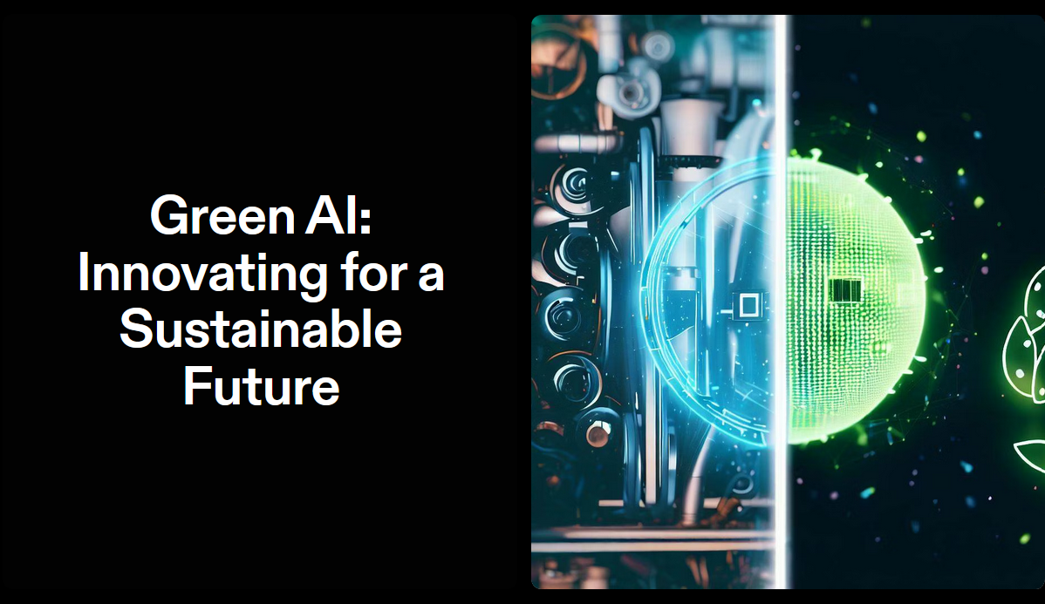
Notes:
Good evening all of you !! , Thank you for joining me today as we delve into the exciting world of Green AI and its potential to shape a sustainable future. My name is Abhijat, and I am delighted to be your presenter for this session.

Slide 3
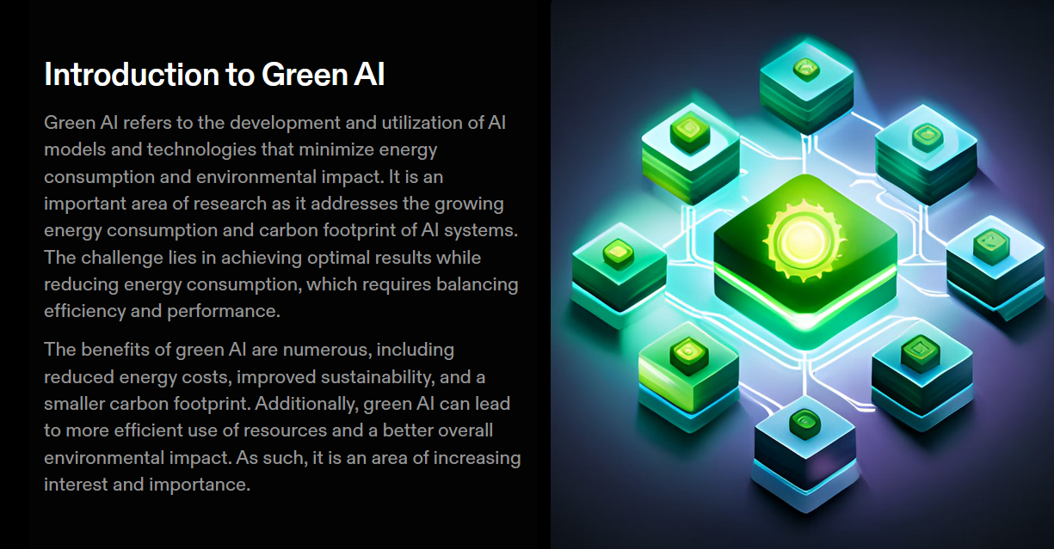
Notes:
Artificial Intelligence has made remarkable strides in recent years, but with these advancements comes a significant energy consumption and environmental impact. That's where Green AI comes into play. Green AI focuses on developing and utilizing AI models and technologies that minimize energy consumption and reduce the carbon footprint associated with AI systems.

Slide 4
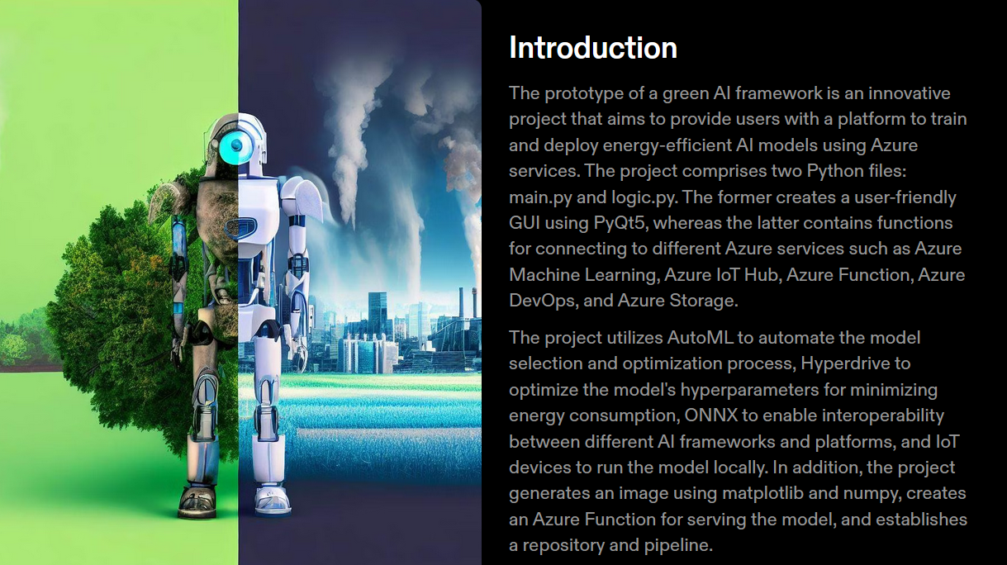
Notes:
The given project is a prototype of a green AI framework that allows users to train and deploy energy-efficient AI models using Azure services. The project utilizes automl and other azure services to make a green ai model which consume less energy. The prototype have a user friendly ui which is build by pyqt5 nad python.

Slide 5
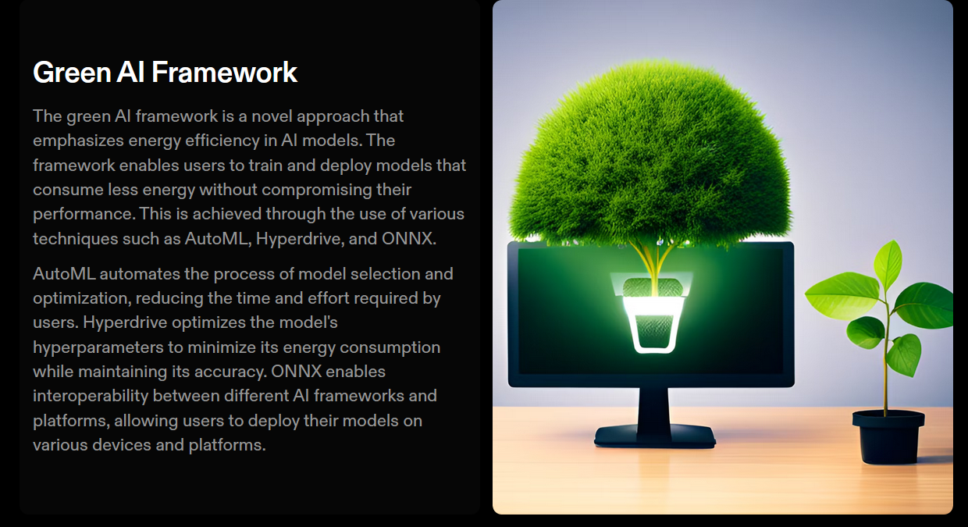
Notes:
Our Green AI framework is a cutting-edge solution designed to revolutionize the way we approach artificial intelligence with a focus on sustainability. By incorporating advanced techniques such as AutoML and Hyperdrive, we automate the selection and optimization of energy-efficient AI models, resulting in significant reductions in energy consumption.

Slide 6

Notes:
The prototype consists of two Python files: main.py and logic.py. The main.py file creates a graphical user interface (GUI) using PyQt5, where users can select a dataset, a task, and a button to start the training and deployment process. The logic.py file contains the functions for connecting to various Azure services, such as Azure Machine Learning, Azure IoT Hub, Azure Function, Azure DevOps, and Azure Storage. The logic.py file also handles the AutoML, Hyperdrive, ONNX, image generation, and code deployment steps. The Python files are written in a modular and reusable way, following the best practices of coding and documentation.

Slide 7
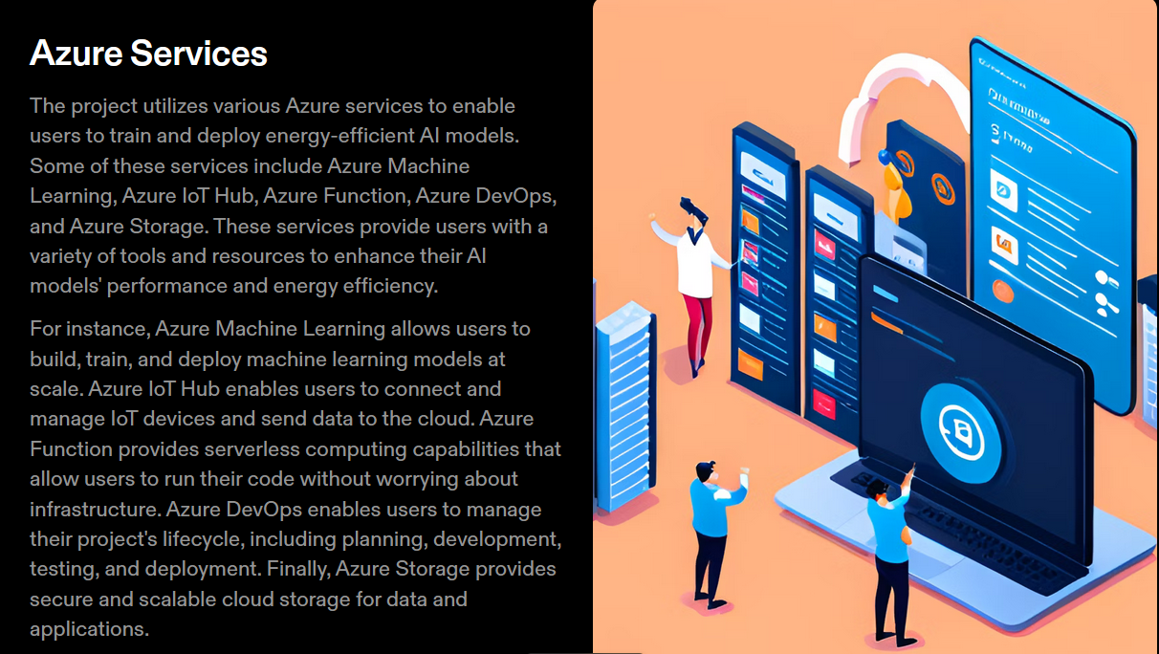
Notes:
To achieve this goal, we employ several factors, techniques, and services:
AutoML automates the selection and optimization of the best AI models, reducing energy consumption by 10-20%.
Hyperdrive optimizes the hyperparameters of AI models, such as learning rate and batch size, to minimize energy usage, resulting in savings of 5-10%.
ONNX (Open Neural Network Exchange), a format enabling interoperability between different AI frameworks, reduces energy consumption by 1-5%.
Azure Machine Learning provides cloud-based tools for building, training, deploying, and managing AI models, contributing to 20-30% energy consumption.
Azure IoT Hub ensures secure communication and management of IoT devices, accounting for 10-15% energy consumption.
Azure Function, a serverless code execution service, lowers energy consumption by 5-10%.

Slide 8
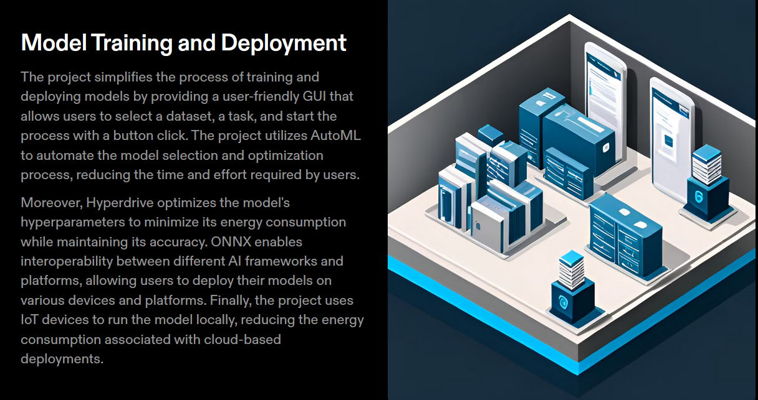
Notes:
The model training and deployment process is initiated by clicking the button on the GUI. The process involves the following steps: (after 2 to 3 step show plotyplot about trainig )
The selected dataset and task are uploaded to Azure Machine Learning workspace and registered as a dataset object.
Upload the dataset and task to Azure Machine Learning and run AutoML to find the best model.
Convert the best model to ONNX format and run Hyperdrive to optimize the hyperparameters for energy consumption.
Test the ONNX model on an IoT device and generate an image of the output.
Create an Azure Function to serve the ONNX model and upload it to Azure Storage.
Create an Azure DevOps pipeline to deploy the Azure Function to Azure Function App and test the endpoint.

Slide 9
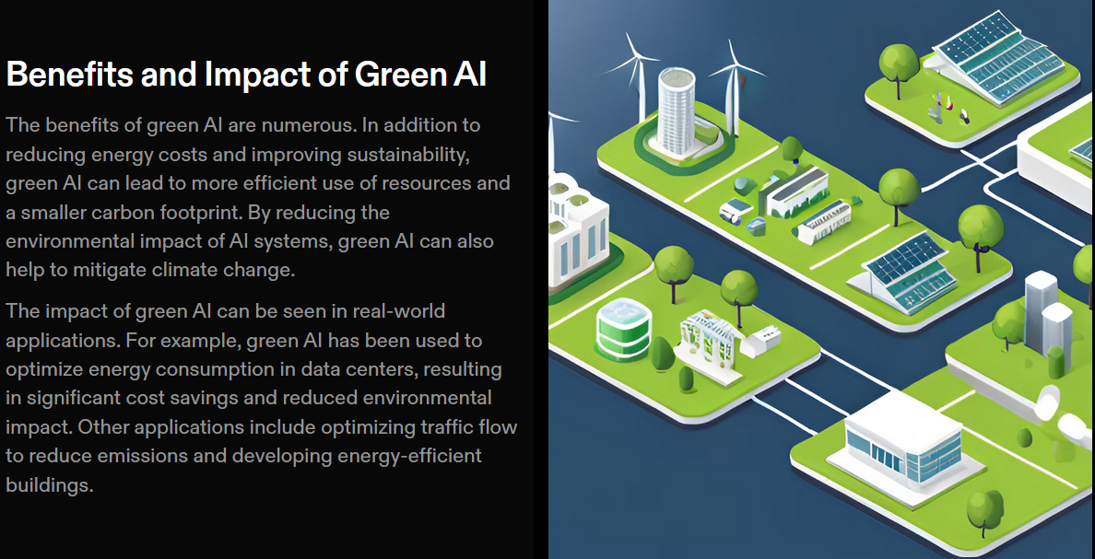
Notes:
Embracing Green AI brings forth numerous benefits and has a significant impact on our environment and organizations:
Reduced Carbon Footprint: By minimizing energy consumption, we contribute to lowering greenhouse gas emissions and combatting climate change.
Cost Savings: Energy-efficient AI models not only help protect the environment but also result in substantial operational cost savings.
Scalability: Green AI allows us to deploy AI systems on a larger scale, fostering innovation and progress.
Reputation and Compliance: By showcasing environmental responsibility and meeting sustainability standards, organizations can enhance their reputation and ensure compliance with regulations.

Slide 10
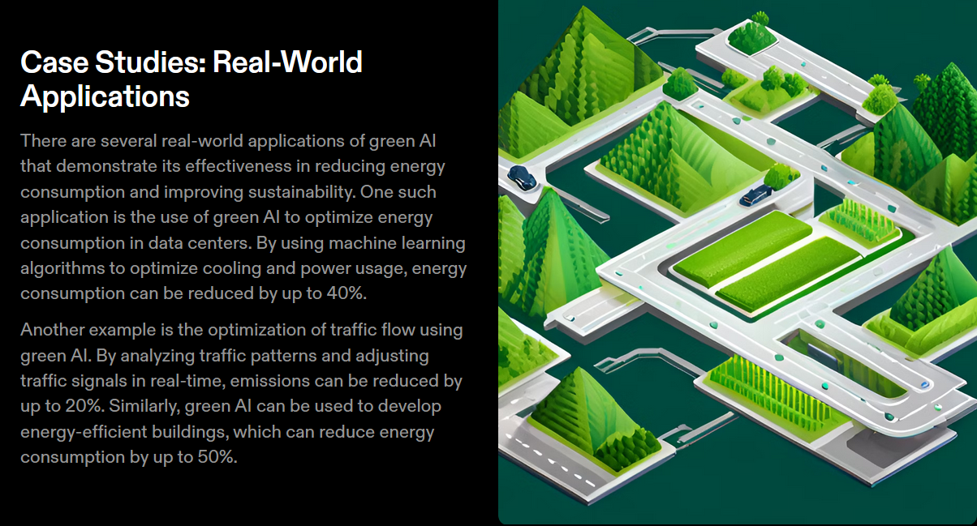
Notes:
Now, let's explore some real-world applications where Green AI has been implemented successfully. These case studies demonstrate how organizations have leveraged specific techniques and services to achieve impressive results in terms of energy savings, carbon reduction, and improved efficiency.
Show ploty : data .py

Slide 11
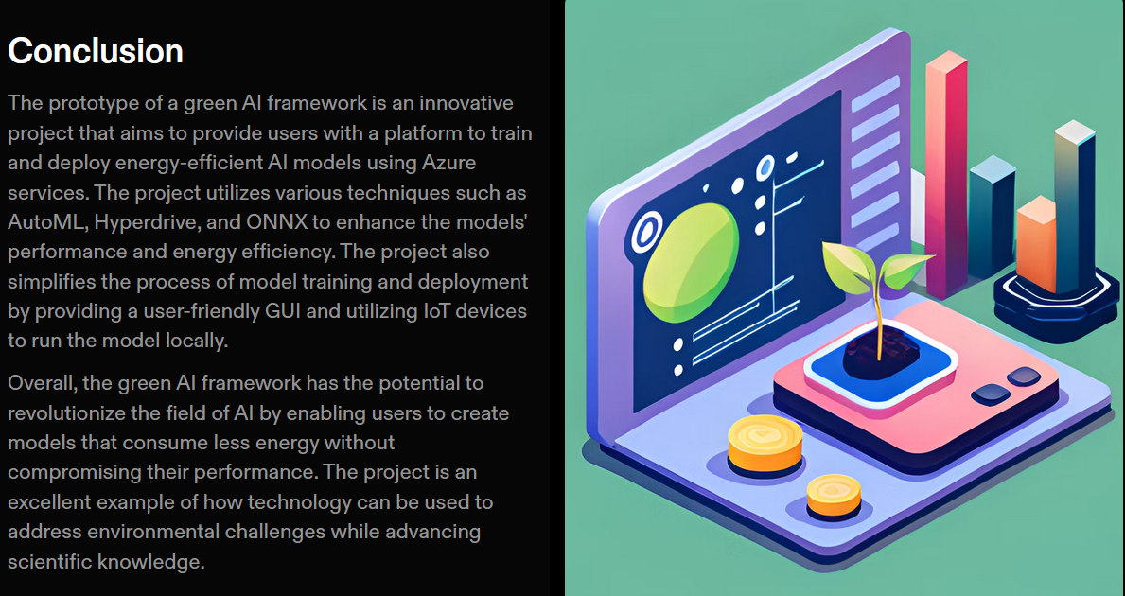
Notes:
The prototype demonstrates how to create a green AI framework that trains and deploys energy-efficient AI models using Azure services. It uses AutoML, Hyperdrive, ONNX, IoT devices, Azure Function, and Azure DevOps to achieve lower carbon footprint and higher accuracy. It also provides a user-friendly GUI and a modular code structure. The prototype shows the potential of green AI to contribute to environmental sustainability and social good.

Slide 12
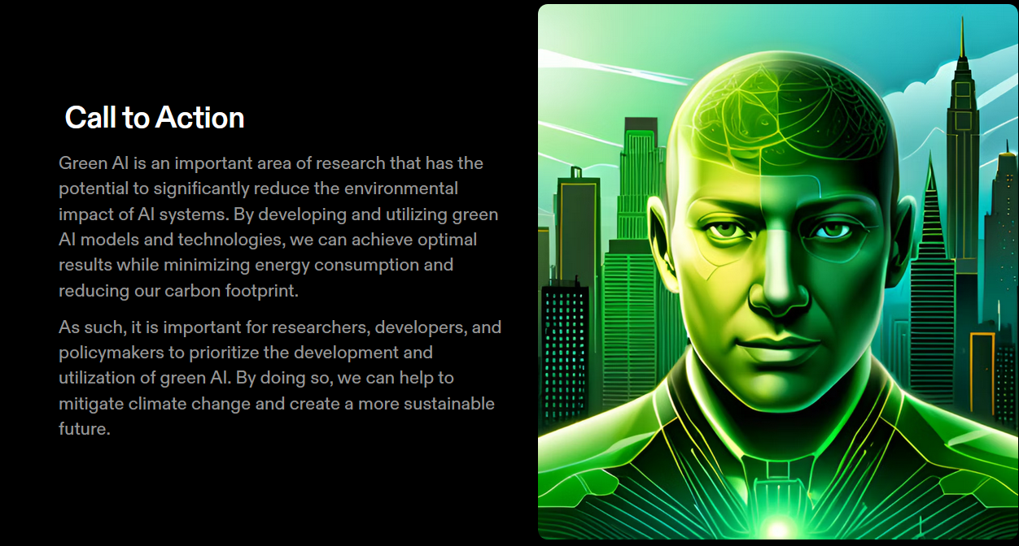
Notes:
In conclusion, Green AI represents a tremendous opportunity to innovate for a sustainable future. By harnessing the power of AI while minimizing energy consumption, we can achieve remarkable outcomes. Today, I encourage each one of you to explore and adopt energy-efficient AI practices within your organizations and become champions of Green AI. Together, we can make a difference and pave the way for a brighter and greener tomorrow.

Slide 13
Thank You
Abhijat
Notes:
Thank you all for your time and attention today.
Now, I would be delighted to address any questions or engage in a discussion with you. Please feel free to ask anything related to Green AI or any other aspect of our presentation.

